Slide 1

Diamond Price Predictions
By: Alexander Olvera

Slide 2

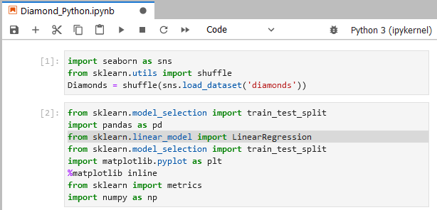



First, we install our packages in a Python file.

Slide 3
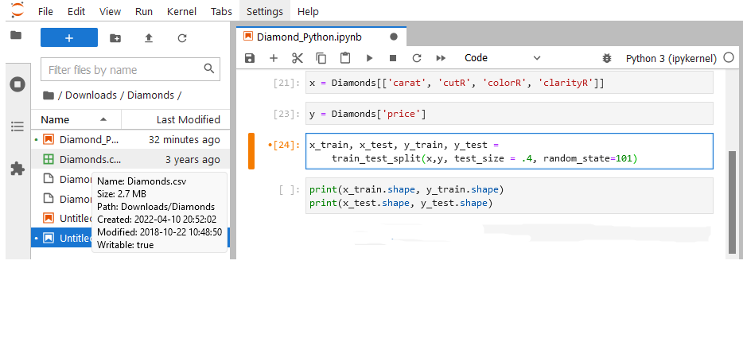
With the provided Diamond Excel data, we will use the columns named 'Carat', 'Cut', 'Color', and 'Clarity' for the x variable. The 'Price' column will be used for the y variable. We will then split our data into 4 data sets named: 'x_train', 'x_test', 'y_train', and 'y_test'. The train test split code is then set up with the 4 data sets defined with the 2 data types x and y. For this example I used a 60/40 ratio of data to be learned and tested. The test size will be 40% of all the data or '.4' .

Slide 4
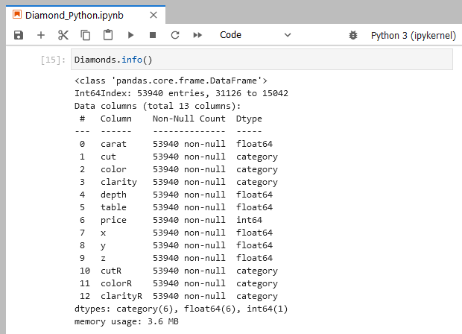
Before we start any tests, we need to implement "Data Wrangling" with the current data. From the columns we are using, their data types need to be numerical.

Slide 5
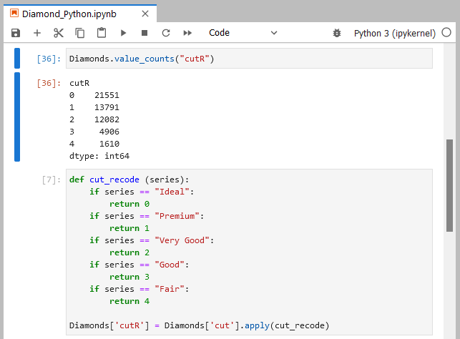
Here we can see that the values in the 'cut' column of 'Diamonds' data are phrases and not numerical values. By running the code below, we can convert the phrases of cuts into a numerical ranking system. We then check the column after with the code listed above and see that there are 21,551 iterations of "ideal" cuts, now labeled "0", 13,791 iterations of "Premium" cuts, now labeled "1", and so on. We will transform the data in the 'color' and 'clarity' as well. By using the code: Diamonds.drop(['cut', 'color', 'clarity'], axis=1, inplace=True) we will drop the old columns and use the newly wrangled columns for the model.

Slide 6
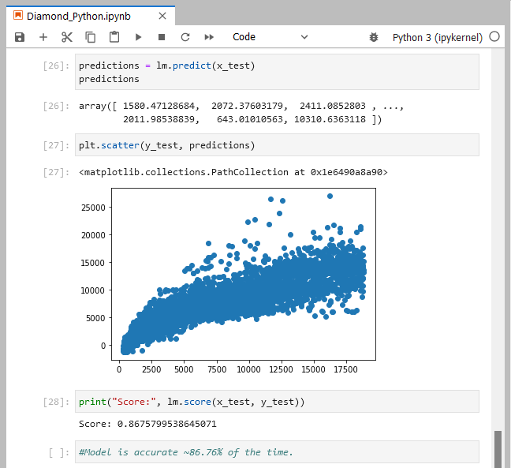
We will use the code: lm = LinearRegression() lm.fit(x_train, y_train) to set up the linear regression model. With that complete, we run the predictions and get an array created by the model. The predictions care then modeled on a graph, visually explaining that this model set up has around an 86.76% accuracy with predicting the price of a diamond.

Slide 7
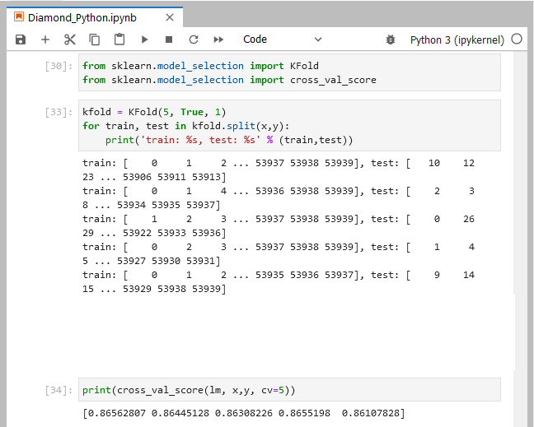
With the Diamonds data and model created, we'll be cross-validating it using the k-folds method. With the kfold code, I chose 5 iterations and the data to be randomized. The results have shown that the five trained models were accurate ~86% of the time, proving that the model put together is consistently accurate ~86% of the time overall.

